Slide 1
Lecture 10

Slide 2
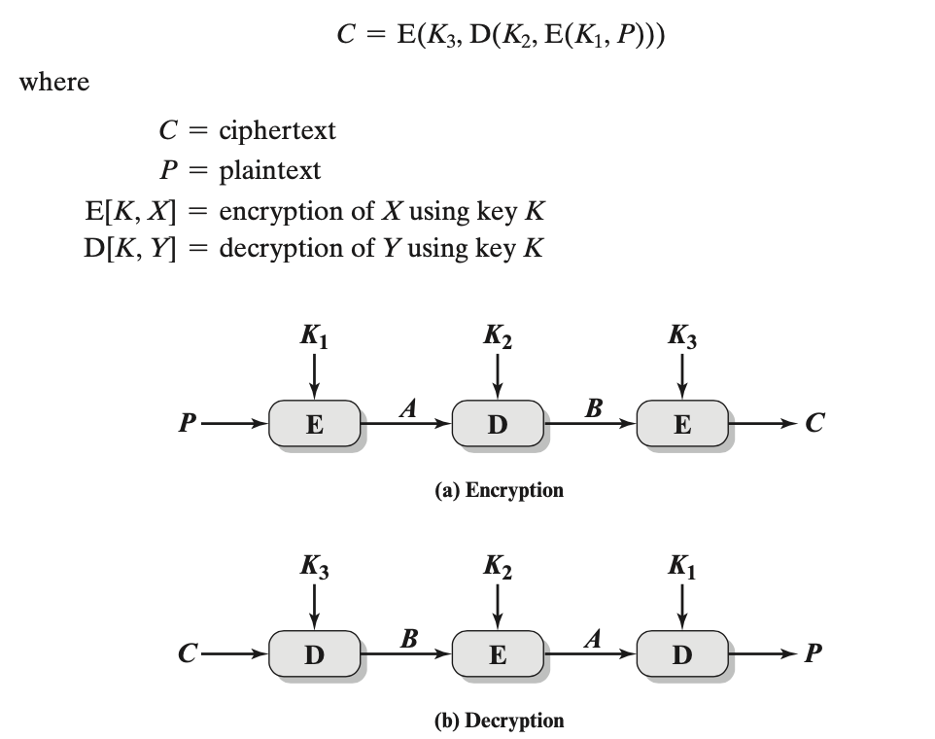
Triple DES (3DES)
Notes:
jumble-up, Decrypting with the wrong key will further convolute the output. 3DES is a feistel cipher structure, encryption and decryption are symmetrical

Slide 3
3DES
Triple DES with three keys – brute-force complexity 2¹⁶⁸
3DES is the FIPS-approved symmetric encryption algorithm
Weakness: slow speed for encryption

Slide 4
Why not 2DES?
Man in middle attack!!
C = E(K₂, E(K₁, P))

Slide 5
AES
clearly a replacement for DES was needed
have theoretical attacks that can break it
have demonstrated exhaustive key search attacks
can use Triple-DES – but slow with small blocks
US NIST issued call for ciphers in 1997
15 candidates accepted in Jun 98
5 were short-listed in Aug-99
Rijndael was selected as the AES in Oct-2000
issued as FIPS PUB 197 standard in Nov-2001

Slide 6
Criteria to evaluate AES
General security
Software implementations
Restricted-space environments
Hardware implementations
Attacks on implementations
Encryption versus decryption
Key agility
Other versatility and flexibility
Potential for instruction-level parallelism
Cryptographic Standards and Guidelines | CSRC (nist.gov)

Slide 7
AES Requirements
private key symmetric block cipher
128-bit data, 128/192/256-bit keys
stronger & faster than Triple-DES
active life of 20-30 years (+ archival use)
provide full specification & design details
both C & Java implementations
NIST have released all submissions & unclassified analyses

Slide 8
The AES Cipher - Rijndael
designed by Rijmen-Daemen in Belgium
has 128/192/256 bit keys, 128 bit data
an iterative rather than feistel cipher
treats data in 4 groups of 4 bytes
operates an entire block in every round
designed to be:
resistant against known attacks
speed and code compactness on many CPUs
design simplicity

Slide 9
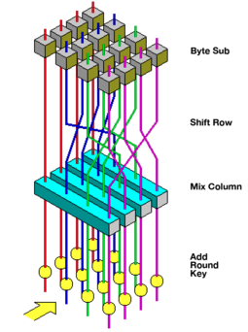
Rijndael
processes data as 4 groups of 4 bytes (state) = 128 bits
has 9/11/13 rounds in which state undergoes:
byte substitution (1 S-box used on every byte)
shift rows (permute bytes between groups/columns)
mix columns (alter each byte in a column as a function of all of the bytes in the column)
add round key (XOR state with key material)
128-bit keys – 10 rounds, 192-bit keys – 12 rounds, 256-bit keys – 14 rounds

Slide 10
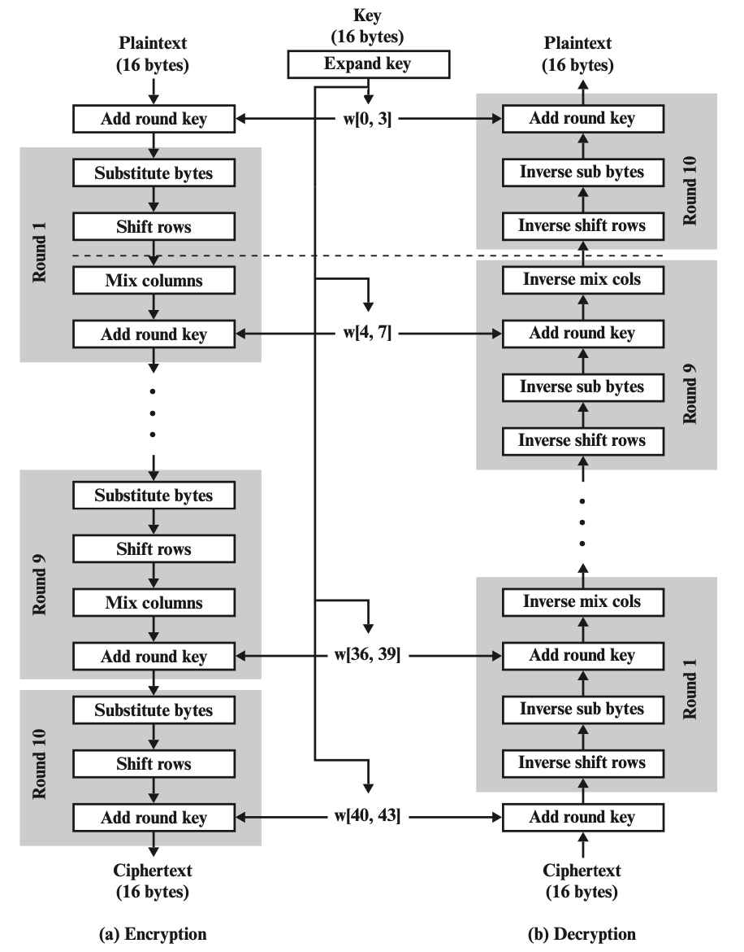
AES Encryption and Decryption

Slide 11
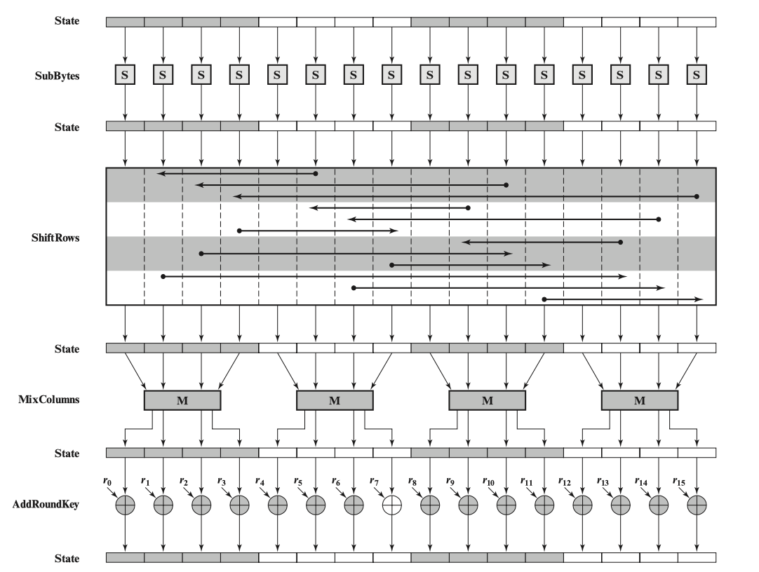
AES encryption round

Slide 12
AES pros
all operations can be combined into XOR and table lookups - hence very fast & efficient

